Slide 1
Stabilisation using Cement,Lime and Chemicals
Presented By:Georgee K Marret
S7CA,18

Slide 2
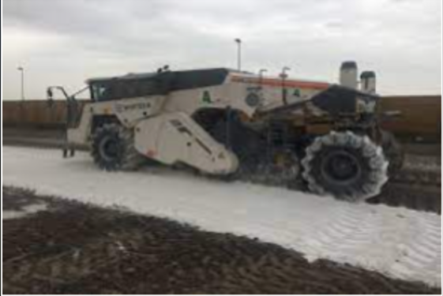
Stabilisation Using Cement
Soil stabilization with cement is a construction technique that improves the strength and stability of soil by mixing it with cement and water
Process
The soil is loosened, mixed with cement, shaped, and compacted.
Additional water may be added to fully hydrate the cement.
The soil should be compacted within four hours of adding the cement.

Slide 3
Soil types
Cement stabilization is best for coarse-grained and gravely soils. It's less effective for clay soils, which may require a higher dose of cement and be more expensive than using lime products.
Chemical reaction
When mixed with water, the cement undergoes a hydration reaction that creates calcium silicate hydrate (CSH) gel. This gel binds the soil particles together.
Mechanism
The gel/crystalline theory describes the different stages of curing. In the initial stages, the cement particles form a gel-like film that coats the soil particles. The cement then sets, and the single crystals grow into a crystalline network

Slide 4
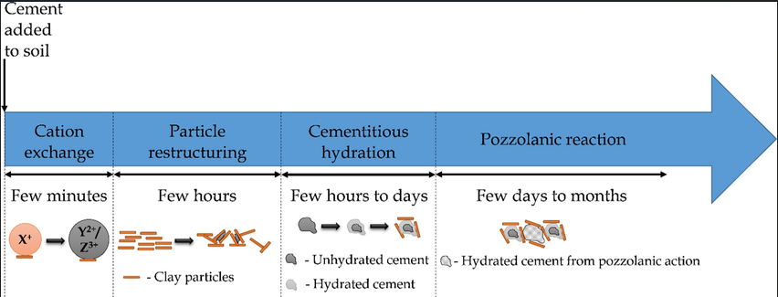
Factors that affect strength
The strength of the stabilized soil is affected by the percentage of cement, the degree of compaction, and the curing period and temperature.
Benefits
Cement stabilization increases the strength of soil, especially when saturated, and reduces its permeability and resistance to erosion

Slide 5
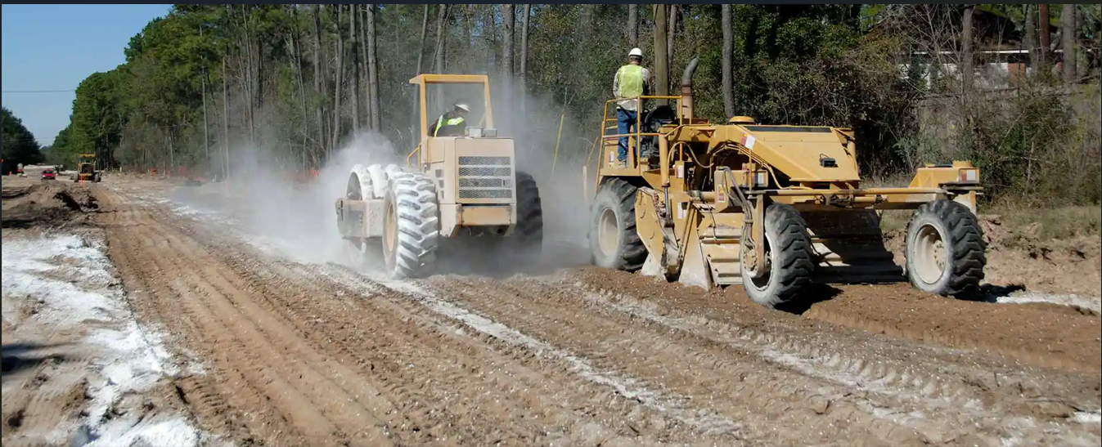
Stabilisation Using Lime
Lime is mixed with soil to enhance its engineering properties
Processes:
The process involves spreading lime, mixing it with soil, compacting the mixture, and allowing it to cure.
Soil Types:
Best suited for clayey soils and silty soils with high plasticity.
Less effective for sandy soils and organic soils.

Slide 6
Chemical Reactions:
Immediate Reaction: Lime reacts with water, causing hydration and releasing calcium hydroxide (Ca(OH)₂), which increases the soil pH.
Long-term Reaction: The high pH promotes pozzolanic reactions between calcium from lime and silica/alumina in the soil, forming cementitious compounds like calcium silicate hydrate (C-S-H) and calcium aluminate hydrate (C-A-H).
Mechanism:
Short-term: Flocculation and agglomeration of soil particles reduce plasticity and improve workability.
Long-term: Pozzolanic reactions result in cementing, which strengthens the soil.

Slide 7
Factors Affecting Strength:
Soil type: Higher clay content leads to more significant improvements.
Lime content: Adequate lime percentage is crucial for optimal stabilization.
Curing time and temperature: More time and higher temperatures favor pozzolanic reactions.
Moisture content: Sufficient water is necessary for chemical reactions.
Benefits:
Increases strength and durability.
Improves workability and load-bearing capacity.
Reduces shrinkage and plasticity of clayey soils.
Effective in controlling swelling in expansive soils.

Slide 8
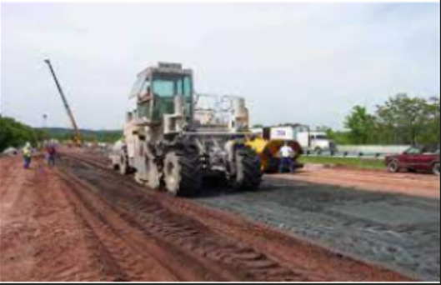
Stabilisation Using Chemicals
Processes: Chemical stabilizers like cement, fly ash, sodium silicate, or polymers are mixed with soil. The process involves application, mixing, compaction, and curing.
Soil Types:
Suitable for a wide range of soils, including clayey, sandy, and silts.
Effective for problematic soils like expansive or loose soils.

Slide 9
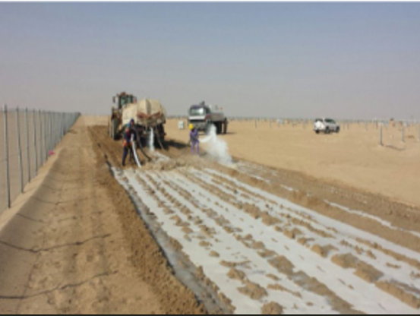
Chemical Reactions:
Cement-based stabilizers: Hydration reactions form calcium silicate hydrate (C-S-H), binding soil particles.
Fly ash: Reacts with calcium (when combined with lime or cement) to form pozzolanic compounds.
Polymers: Form a physical or chemical bond with soil particles to improve cohesion.
Mechanism:
Cementation: Chemical reactions create binding agents between soil particles, increasing strength.
Reduction in Plasticity: Stabilizers decrease soil plasticity and improve particle cohesion.

Slide 10
Factors Affecting Strength:
Soil type: The chemical stabilizer's effectiveness depends on soil properties (e.g., clay content, particle size).
Type of chemical: The choice of chemical greatly affects performance (e.g., cement vs. polymer).
Concentration: Adequate chemical dosage is critical for achieving desired results.
Curing conditions: Time and environmental conditions influence the strength development.

Slide 11
Benefits:
Increases soil strength and load-bearing capacity.
Reduces settlement and shrink-swell potential in expansive soils.
Improves water resistance and reduces erosion.
Cost-effective and adaptable to various soil types.

Slide 12
THANK YOU

